Slide 1

Road Accident Project Report
REQUIREMENTS
Clients wants to create a Road Accident Dashboard for year 2021 and 2022 so that they can have on the below requirements- 1. Primary KPI – Total Casualties taken place after the accident. 2. Primary KPI’s – Total Casualties and Percentage of total with respect to accident severity and maximum casualties by type of vehicle. 3. Secondary KPI’s – Total Casualties with respect to vehicle type. -> Monthly trend showing comparison of casualties for current year and previous year. -> Maximum casualties by Road Type. -> Distribution of total casualties by Area/ Location & by Day/ Night.
PRESENTER: [Abhishek Sah]
01

Slide 2

STAKEHOLDERS Road Transport Department Police Force Emergency Services Department Transport Operators Public Media
02

Slide 3
METADATA File Extension - .xlsx No Of Rows = 3.07 Lacks No Of Fields - 21
03

Slide 4
STEPS TAKEN TO MAKE THE PROJECT ARE AS FOLLOWS 1. Data Cleaning : The Data Cleaning Process We clean the data so that there should not be any duplicate values in our dataset and also there should not be any blanks in the columns. 2. Data Processing : In this have one requirement where we want to show the trend line for current year and previous year casualties so the trend line, we show the monthly trend. We make the monthly trend column and year column. 3. Data Analysis : In the data Analysis and visualization we will use the pivot table . 4. Data Visualization : Making the visual effect and slicer for visualizing the data easily. 5. Dashboard : Finally make the dashboard to make the overall visualization of data.
04

Slide 5

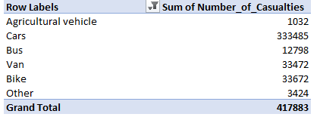
The require KPI which is given by our clients are first we have to find the total number of casualties happened in the year of 2021 and 2022.
So here I have added the total casualties by adding the all types of severity.
After that the second requirement which was the Total Casualties and Percentage of total with respect to accident severity to find that I have used the formula =E10/($E$10+$E$11)
So here I got the total severity percentage when the situation was Fatal (1.7%) and for Serious severity the percentage is 14.2% and for slight severity, I got 84.1%.
After that I found the casualties which happened by the types of vehicles so here in pivot table, we can clearly see that the most of casualties happened by Car followed by Van and Bike and so on.
05

Slide 6
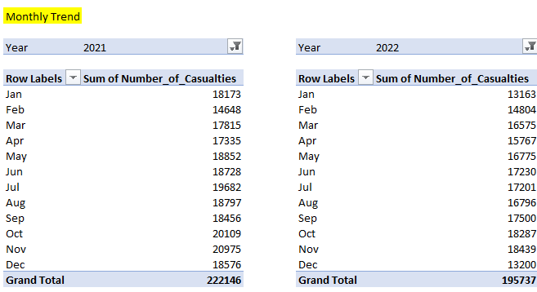
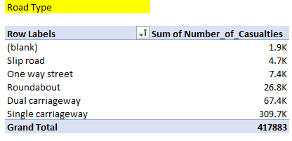
Our Secondary KPI was to find the monthly trends of the years 2021 and 2022.
Here we can clearly see, in the pivot table in the year 2021 there are higher number of casualties compare to next year. Here in monthly trend, we can see that in which month high numbers of casualties happened.
The second pivot table which shows that the total casualties by the types of roads, here the more numbers of accident was occurred in the single carriageway followed by dual and roundabout and so on.
06

Slide 7
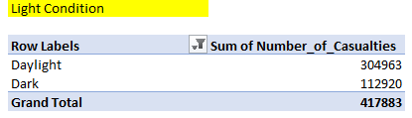
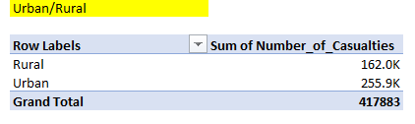
The last two requirements are to find the light condition when the Accident happened that is whether it was happened in day or in night and the last one is the where is accident happened, whether it is in urban area or in rural areas, here we can clearly see that in a day there is more chances of accident and in second pivot table, there is more numbers of accident happened in Urban Area.
07

Slide 8
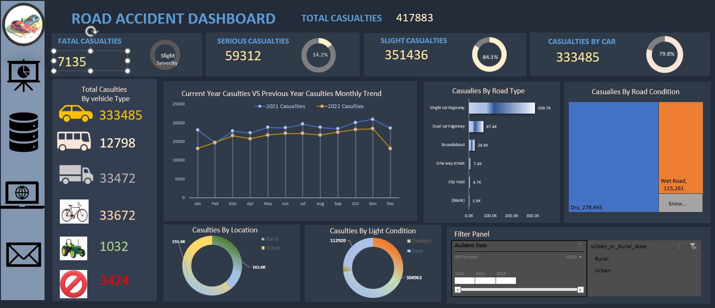
08

Slide 9
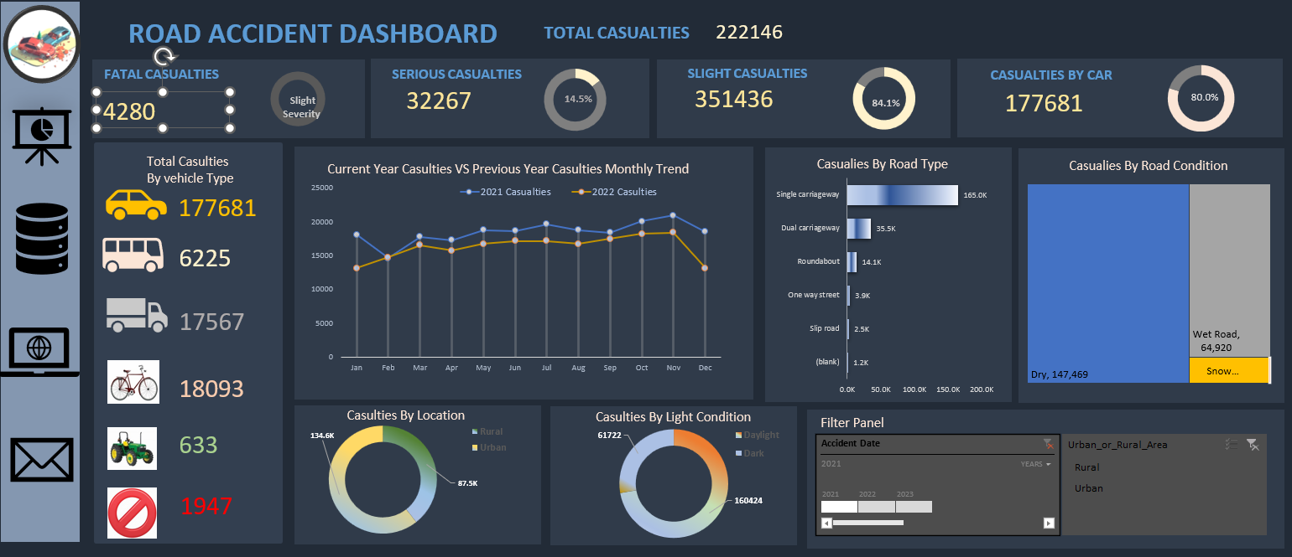
09

Slide 10
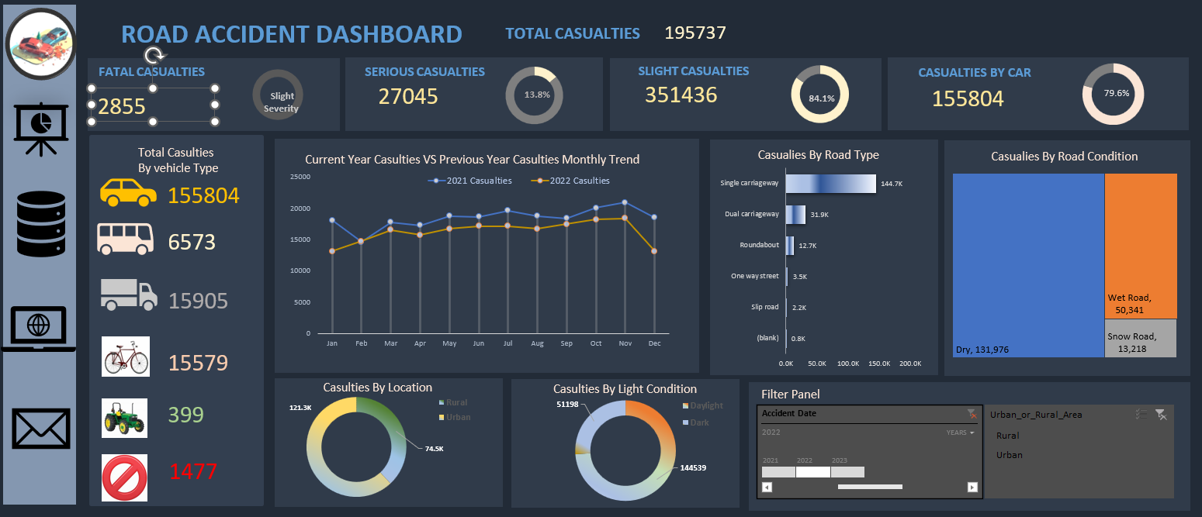
10

